Slide 1


project
Land
Name | Ahmed Mahmoud Abdelazim Allam
Code | NEXT81_ONL1_ERB8_M1d
Student ID | 21026939
0ahmed.m.allam0@gmail.com
reclamation

Slide 2
Name | Ahmed Mahmoud Abdelazim Allam
Code | NEXT81_ONL1_ERB8_M1d
Student ID | 21026939
Land
reclamation
project
0ahmed.m.allam0@gmail.com

Slide 3
reclamation
Situation
Our company, Green Horizon, specializes in land reclamation, including well drilling, solar energy installations, and agricultural landscape projects. We have received a request from AgriCorp, a local agricultural business, to reclaim a parcel of land for agricultural use. This project presents a significant opportunity for us.
The land currently lacks essential utilities, including water and electricity, and requires comprehensive development before planting crops. Our goal is to prepare the site for sustainable agricultural production, ensuring all necessary infrastructure is in place.
project
Land
Name | Ahmed Mahmoud Abdelazim Allam
Code | NEXT81_ONL1_ERB8_M1d
Student ID | 21026939

Slide 4
W
O
Effect:
1-Soil Quality Improvement: The process of land reclamation often includes adding nutrients and organic matter, leading to healthier soil.
2-Utility Installation: The immediate effect of installing water and electricity infrastructure enables agricultural activities.
3-Biodiversity Changes: The introduction of native plants and the removal of invasive species can directly affect local flora and fauna.
4-Local Air Quality Improvement: With sustainable practices in place, the air quality may improve due to reduced pollution from conventional farming methods.
Situation: Our company, Green Horizon, specializes in land reclamation, including well drilling, solar energy installations, and agricultural landscape projects. We have received a request from AgriCorp, a local agricultural business, to reclaim a parcel of land for agricultural use. This project presents a significant opportunity for us.
The land currently lacks essential utilities, including water and electricity, and requires comprehensive development before planting crops. Our goal is to prepare the site for sustainable agricultural production, ensuring all necessary infrastructure is in place.
Name | Ahmed Mahmoud Abdelazim Allam
Code | NEXT81_ONL1_ERB8_M1d
Student ID | 21026939
Impact :
1-Economic Growth: Increased agricultural productivity can lead to job creation and a boost in the local economy.
2-Food Security: Over time, improved agricultural output can enhance food availability and security in the region.
3-Community Well-being: Long-term engagement in sustainable practices can lead to stronger community ties and improved health outcomes.
4-Environmental Sustainability: The project can contribute to long-term ecological balance by promoting renewable energy use and sustainable land practices.
S
T

Slide 5
Effect:
1-Soil Quality Improvement: The process of land reclamation often includes adding nutrients and organic matter, leading to healthier soil.
2-Utility Installation: The immediate effect of installing water and electricity infrastructure enables agricultural activities.
3-Biodiversity Changes: The introduction of native plants and the removal of invasive species can directly affect local flora and fauna.
4-Local Air Quality Improvement: With sustainable practices in place, the air quality may improve due to reduced pollution from conventional farming methods.
Situation: Our company, Green Horizon, specializes in land reclamation, including well drilling, solar energy installations, and agricultural landscape projects. We have received a request from AgriCorp, a local agricultural business, to reclaim a parcel of land for agricultural use. This project presents a significant opportunity for us.
The land currently lacks essential utilities, including water and electricity, and requires comprehensive development before planting crops. Our goal is to prepare the site for sustainable agricultural production, ensuring all necessary infrastructure is in place.
S
W
O
T
Impact :
1-Economic Growth: Increased agricultural productivity can lead to job creation and a boost in the local economy.
2-Food Security: Over time, improved agricultural output can enhance food availability and security in the region.
3-Community Well-being: Long-term engagement in sustainable practices can lead to stronger community ties and improved health outcomes.
4-Environmental Sustainability: The project can contribute to long-term ecological balance by promoting renewable energy use and sustainable land practices.

Slide 6
W
O
SWOT
Strength
-Expertise: Green Horizon has specialized knowledge in land reclamation, well drilling, and solar energy installations. -Sustainable Practices: The project promotes sustainable agricultural methods, aligning with current environmental trends. -Community Support: Local agricultural businesses like AgriCorp are interested in collaboration, enhancing community ties. -Potential for Innovation: Opportunities to implement new technologies in water management and renewable energy.
Opportunities
-Market Demand: Growing demand for organic produce can enhance the viability of the reclaimed land. -Government Incentives: Availability of grants and subsidies for sustainable projects can help offset costs. -Technological Advancements: Innovations in agricultural technology and renewable energy can improve efficiency and yield. -Partnerships: Potential for partnerships with environmental organizations or research institutions for further support.
Weakness
-Initial Costs: High upfront investment required for infrastructure development and soil remediation. -Limited Resources: Potential constraints in manpower and equipment during peak project phases. -Dependence on Utilities: The project relies on establishing water and electricity supplies, which may face regulatory hurdles. -Time Constraints: The complexity of the project could lead to delays in achieving goals.
Threats
-Regulatory Challenges: Compliance with environmental regulations can pose obstacles and delays. -Climate Change: Extreme weather events may impact agricultural viability and project timelines. -Competition: Other companies may also seek to reclaim land for agricultural purposes, increasing competition. -Market Fluctuations: Changes in market prices for agricultural products could affect profitability.
S
T

Slide 7
SMART Goal
Soil Improvement Goal:
Increase the soil health index to 75 or higher by the end of the sixth month.
Water and Electricity Installation Goal:
Achieve 80% of energy needs met by solar panels and establish reliable water sources by the end of month 8.
Crop Planting Goal:
Successfully plant at least 5 different crop types by the end of the first planting season.
Budget Monitoring Goal:
Keep project expenses within 10% of the original budget by monitoring the percentage used at the halfway point.

Slide 8
OKRs
Objective 1: Ensure the project is completed within budget and timeline.
Key Result 1: Maintain project costs within 10% of the original budget.
Key Result 2: Complete all phases of the project by the end of month 10.
Key Result 3: Conduct bi-weekly project reviews to monitor progress and address issues promptly.
Objective 2: Ensure Project Completion Within Budget and Timeline
Key Result 1: Maintain project expenses within 10% of the original budget throughout the project.
Key Result 2: Complete all project phases by the end of month 20.
Key Result 3: Conduct bi-weekly project reviews to address issues promptly and keep the project on track.

Slide 9
Objective 1: Ensure the project is completed within budget and timeline.
Key Result 1: Maintain project costs within 10% of the original budget.
Key Result 2: Complete all phases of the project by the end of month 10.
Key Result 3: Conduct bi-weekly project reviews to monitor progress and address issues promptly.
OKRs
Stakeholders
Objective 2: Ensure Project Completion Within Budget and Timeline
Key Result 1: Maintain project expenses within 10% of the original budget throughout the project.
Key Result 2: Complete all project phases by the end of month 20.
Key Result 3: Conduct bi-weekly project reviews to address issues promptly and keep the project on track.

Slide 10
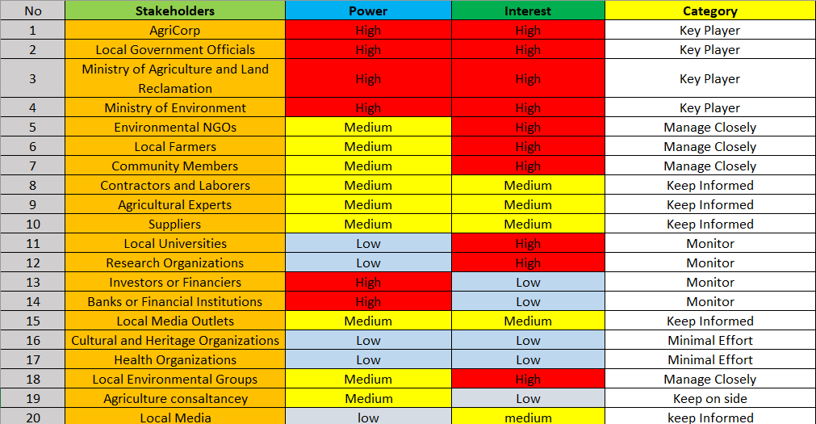
Objective 1: Ensure the project is completed within budget and timeline.
Key Result 1: Maintain project costs within 10% of the original budget.
Key Result 2: Complete all phases of the project by the end of month 10.
Key Result 3: Conduct bi-weekly project reviews to monitor progress and address issues promptly.
Objective 2: Ensure Project Completion Within Budget and Timeline
Key Result 1: Maintain project expenses within 10% of the original budget throughout the project.
Key Result 2: Complete all project phases by the end of month 20.
Key Result 3: Conduct bi-weekly project reviews to address issues promptly and keep the project on track.
OKRs

Slide 11
Investors or Financiers
Banks or Financial Institutions
Environmental NGOs
Local Farmers
Community Members
AgriCorp
Local Government Officials
Ministry of Agriculture
Ministry of Environment
High
Agricultural Consultants
Contractors and Laborers
Agricultural Experts
Suppliers
Local Media Outlets
Local Environmental Groups
Medium
Power
Cultural and Heritage Organizations
Health Organizations
Local Media
Research Organizations
Local Universities
Low
Low
Medium
High
Interest

Slide 12
Investors or Financiers
Banks or Financial Institutions
Environmental NGOs
Local Farmers
Community Members
AgriCorp
Local Government Officials
Ministry of Agriculture
Ministry of Environment
High
Agricultural Consultants
Contractors and Laborers
Agricultural Experts
Suppliers
Local Media Outlets
Local Environmental Groups
Medium
RACI Chart
Power
Cultural and Heritage Organizations
Health Organizations
Local Media
Research Organizations
Local Universities
Low
Low
Medium
High
Interest

Slide 13
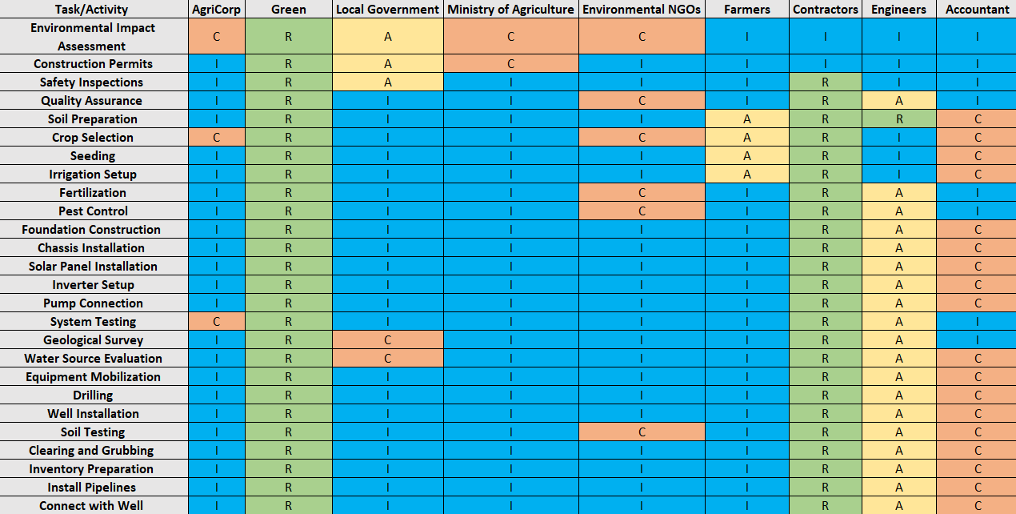
Investors or Financiers
Banks or Financial Institutions
Environmental NGOs
Local Farmers
Community Members
Investors or Financiers
Banks or Financial Institutions
AgriCorp
Local Government Officials
Ministry of Agriculture
Ministry of Environment
Environmental NGOs
Local Farmers
Community Members
AgriCorp
Local Government Officials
Ministry of Agriculture
Ministry of Environment
High
High
Contractors and Laborers
Agricultural Experts
Suppliers
Local Media Outlets
Contractors and Laborers
Agricultural Experts
Suppliers
Local Media Outlets
Local Environmental Groups
Agricultural Consultants
Local Environmental Groups
Medium
Power
Power
Cultural and Heritage Organizations
Health Organizations
Cultural and Heritage Organizations
Health Organizations
Research Organizations
Local Universities
Local Media
Research Organizations
Local Universities
Low
Low
Medium
High
Interest
Interest

Slide 14
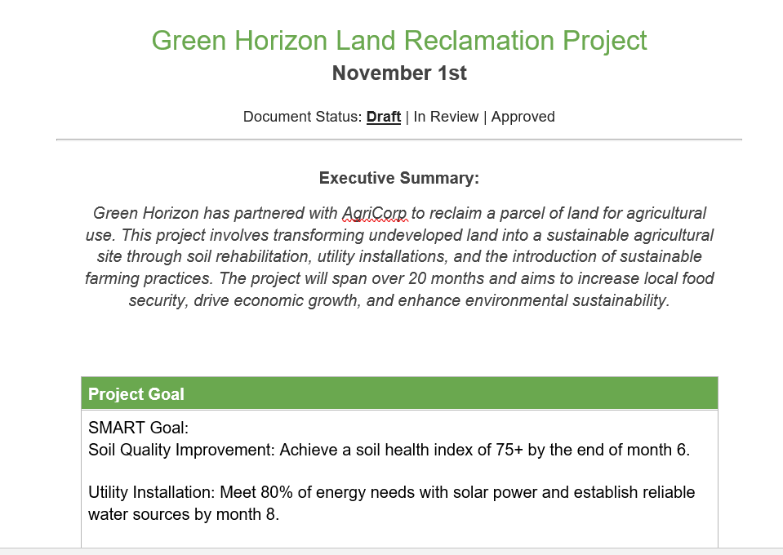
Project Charter
Interest

Slide 15
Project planning
Interest

Slide 16
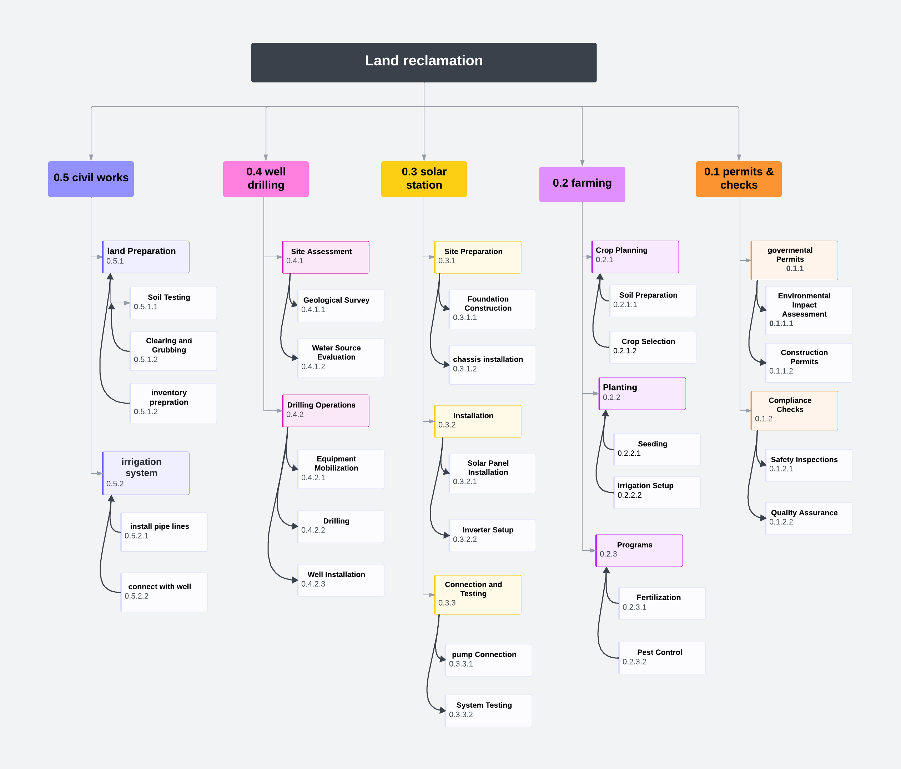
Interest

Slide 17
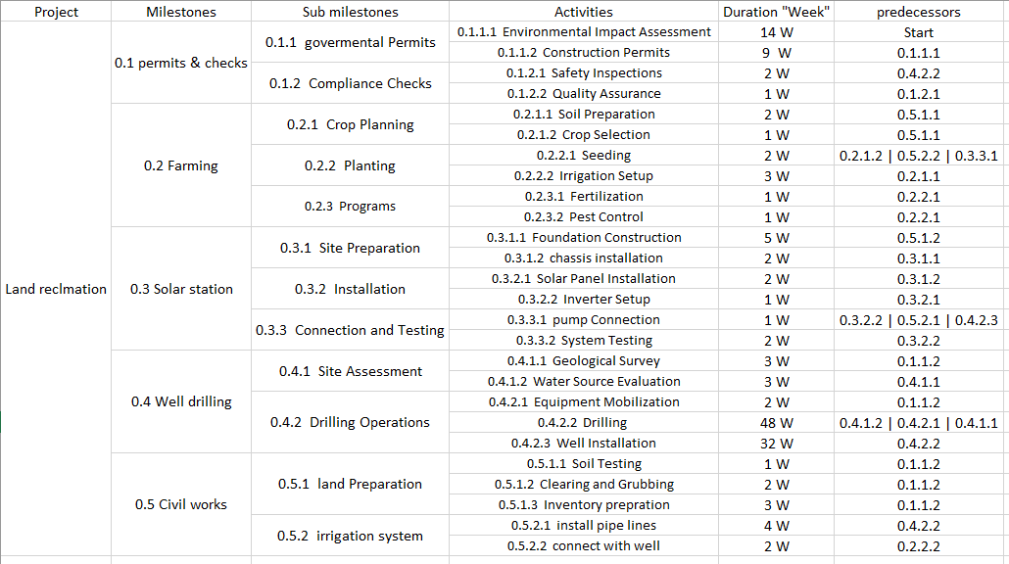
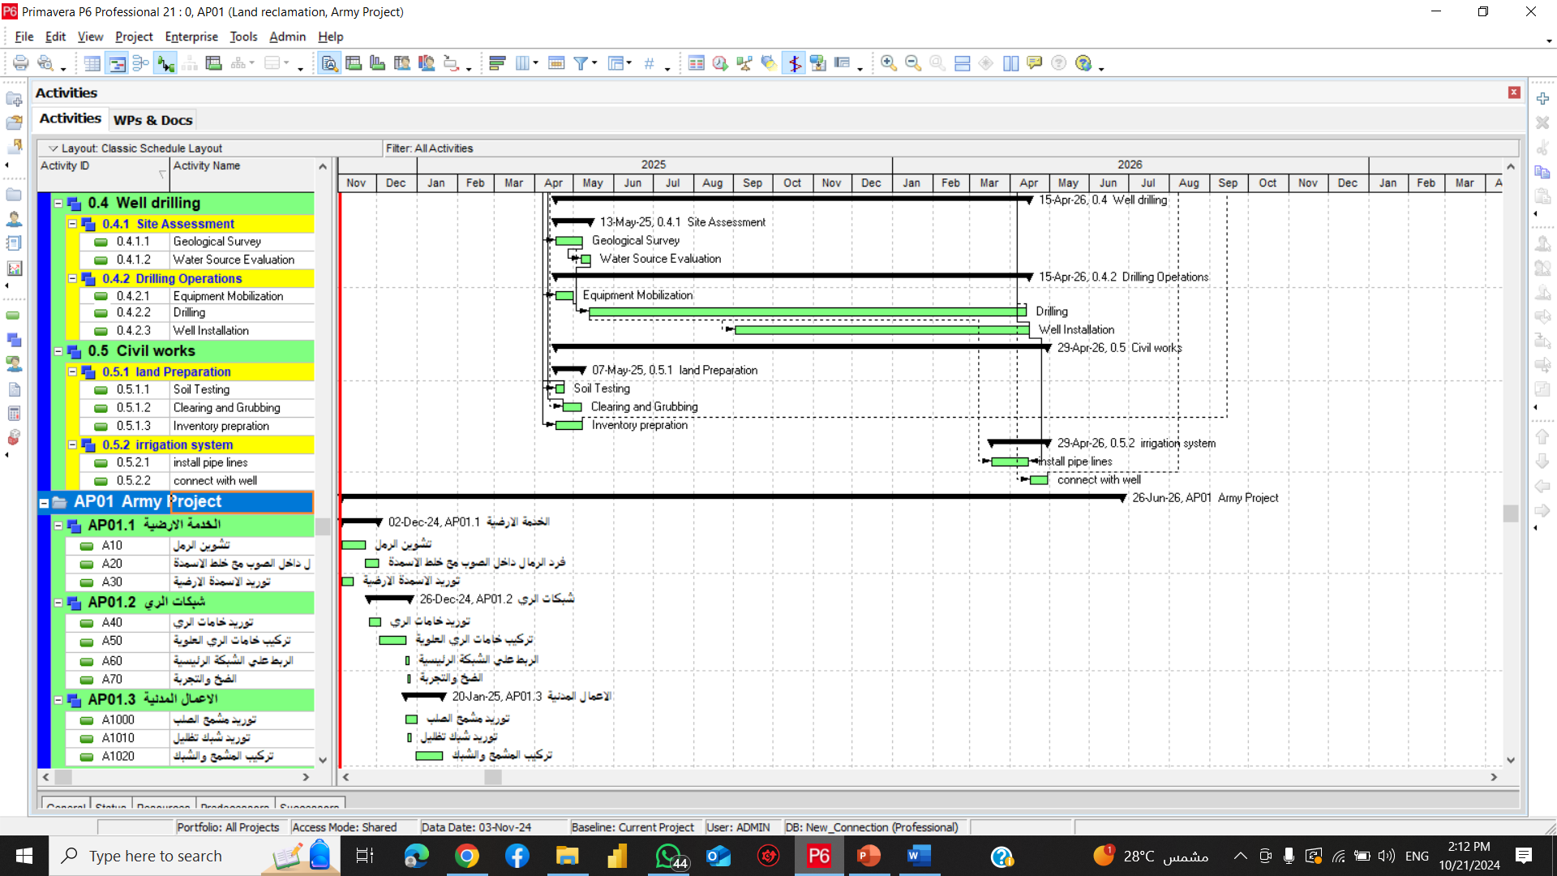

Slide 18
Finish 113
77
2
79
79
1
80
0.1.2.1
0.1.2.2
110
33
112
112
33
113
29
48
77
0.4.2.2
77
32
109
29
0
77
0.4.2.3
112
1
113
77
0
109
0.2.3.2
77
4
81
112
0
113
0.5.2.1
109
1
110
112
1
113
105
28
109
0.3.3.1
0.2.3.1
26
3
29
109
0
110
112
0
113
0.4.1.2
23
3
26
26
0
29
0.4.1.1
23
0
26
23
2
25
24
1
25
0.4.2.1
0.2.1.2
27
4
29
109
85
110
23
3
26
24
2
26
26
3
29
29
2
31
110
2
112
0.5.1.3
0.2.1.1
0.2.2.2
0.5.2.2
0.2.2.1
110
87
113
103
79
105
105
79
108
108
79
110
110
0
112
23
1
24
25
5
30
30
2
32
32
2
34
34
1
35
35
2
37
0.5.1.1
0.3.1.1
0.3.1.2
0.3.2.1
0.3.2.2
0.3.3.2
102
79
103
97
72
102
102
72
104
104
72
106
106
72
107
107
72
109
23
2
25
0.5.1.2
95
72
97
14
9
23
0.1.1.2
14
0
23
0
14
14
0.1.1.1
0
0
14
CP: Start -> 0.1.1.1 -> 0.1.1.2 -> 0.4.1.1 -> 0.4.1.2 -> 0.4.2.2 -> 0.4.2.3 -> 0.3.3.1 -> 0.2.2.1 -> 0.2.3.2/0.2.3.1 -> Finish
Start

Slide 19
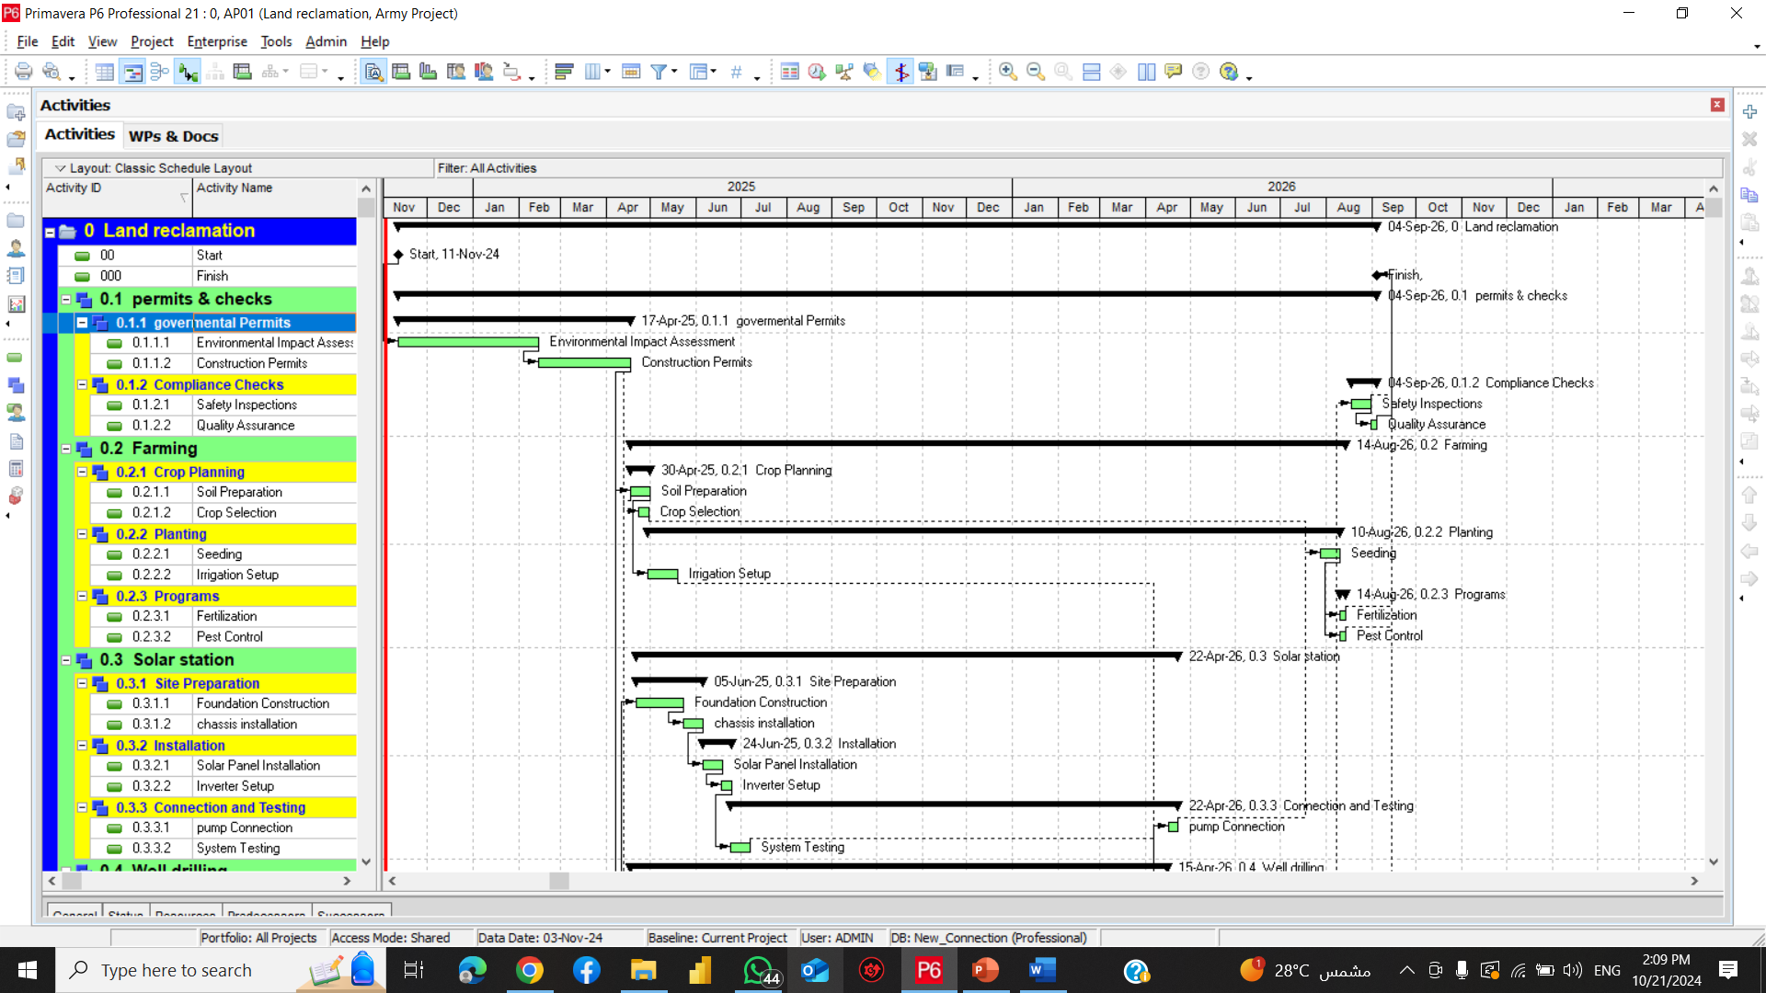

Slide 21
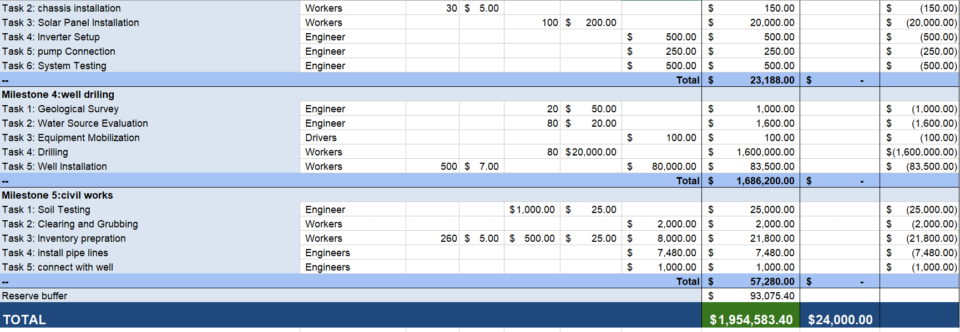

Slide 22
Materials
Environment
Equipment
Unpredictable weather patterns affecting project timelines
Availability of quality organic materials for soil enhancement
Limited access to advanced agricultural technology
Transportation challenges for delivering materials to the site
Presence of invasive species complicating reclamation efforts
Need for specialized machinery for soil restoration and drainage
Potential for soil erosion due to proximity to the river
Variability in seed quality for planting
Maintenance issues with existing equipment
Potential Risks
Delays in regulatory approvals and permits
Lack of skilled labor for specialized tasks
Lack of clear communication among stakeholders
Inefficient project management practices
Insufficient training programs for staff
Budget constraints limiting project scope
Inadequate planning for utility installation (water, electricity)
Community resistance to changes in land use
Processes
Difficulty in measuring project progress and success
People
Management

Slide 23
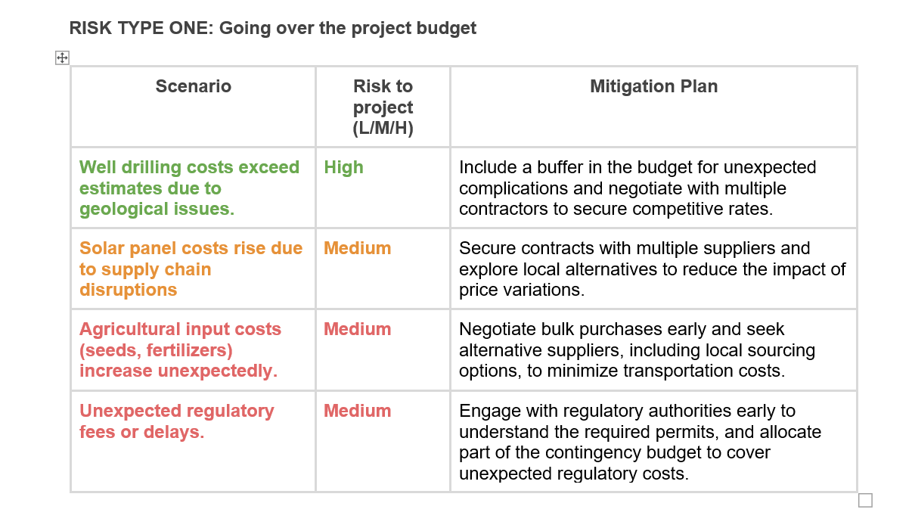

Slide 24
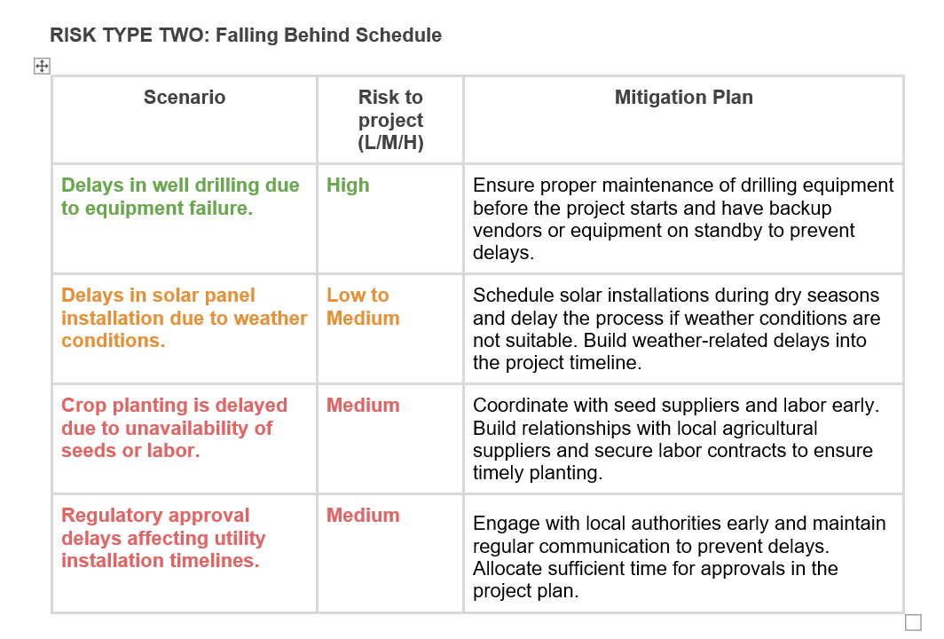

Slide 25
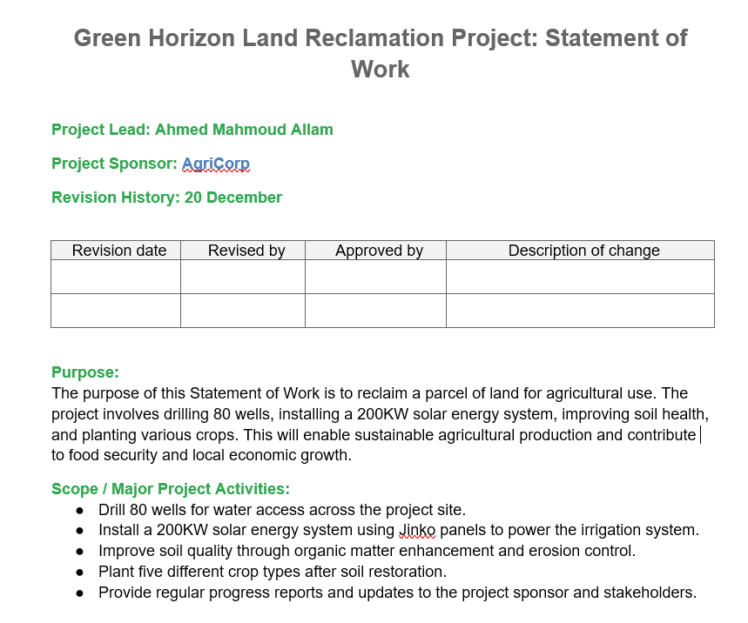
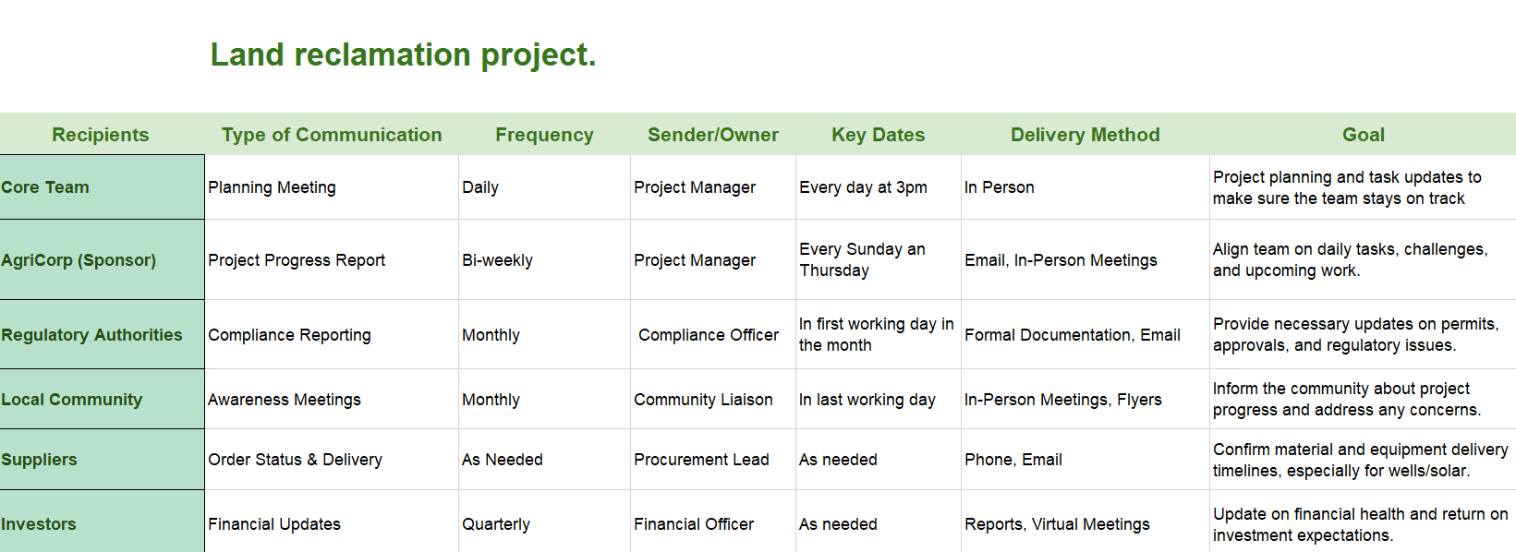

Slide 27
Questions ?!

Slide 28
Questions ?!
Thanks !
Ahmed Mahmoud Allam
0ahmed.m.allam0@gmail.com
+201009854899

